Slide 1

Lending Club Case Study
Aadhar Sharma

Slide 2
Objective
The Objective of this case study is to implement Exploratory Data Analysis (EDA) technique on a real-world problem and understand the insights and present in a business first manner via presentation.
Benefits:
Helps in understanding how risk analytics is done in banking and financial industry.
Maximising profits by minimize loss of money while lending it to clients.

Slide 3
Business Use case
The objective is to to reject or approve a loan based on certain variables.
Dataset Details:
The data given below contains information about past loan applicants and whether they ‘defaulted’ or not. Data has details regarding approved loan not the rejected ones. It has 3 status of loan which is Fully Paid, Current and Charged-Off.
Data Clean-up and preparation process:
Importing the Data
Removing large null value columns
Removing irrelevant columns
Removing/Fixing null values
Correcting data types and deriving new columns
Filter Data for requirement.
Removing Duplicate Data
Removing outliers

Slide 4
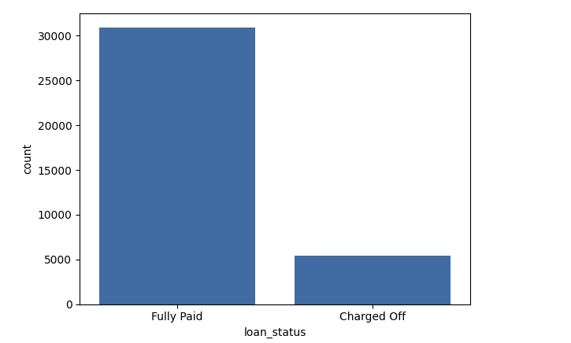
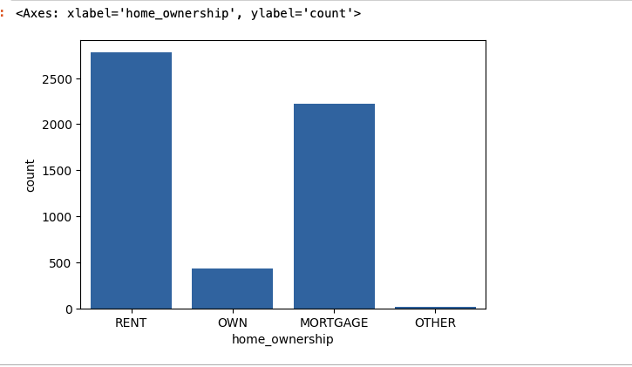
1. Loan Status and Ownership
Loan Status: The number of charged off loan is much smaller(14.70%) compared to total count.
Home_Ownership: Those who are staying on rent have the highest count of defaulting. They are the largest grp to default with 50.99% chances followed by Mortgage with 40.69% probability

Slide 5
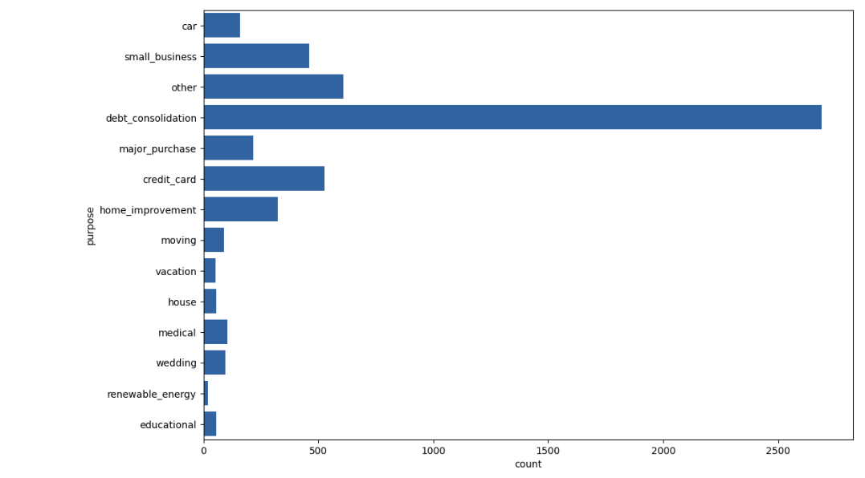
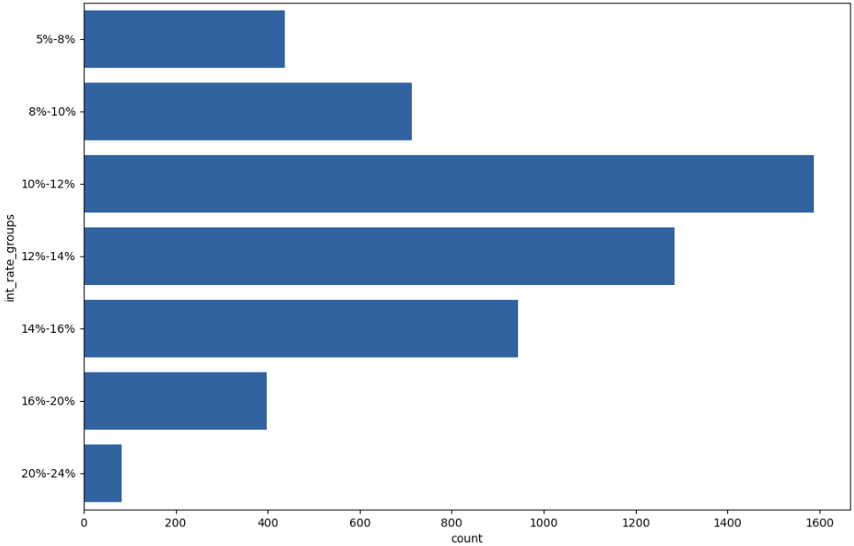
2. Purpose and Interest_rates
Purpose: 49.39% of the defaulters are under debt consolidation.
Interest_rates: Max defaulters are with interest rates between 10-12% followed by a group with ranges in 12-14% Min defaulters are in 20-24% interest

Slide 6
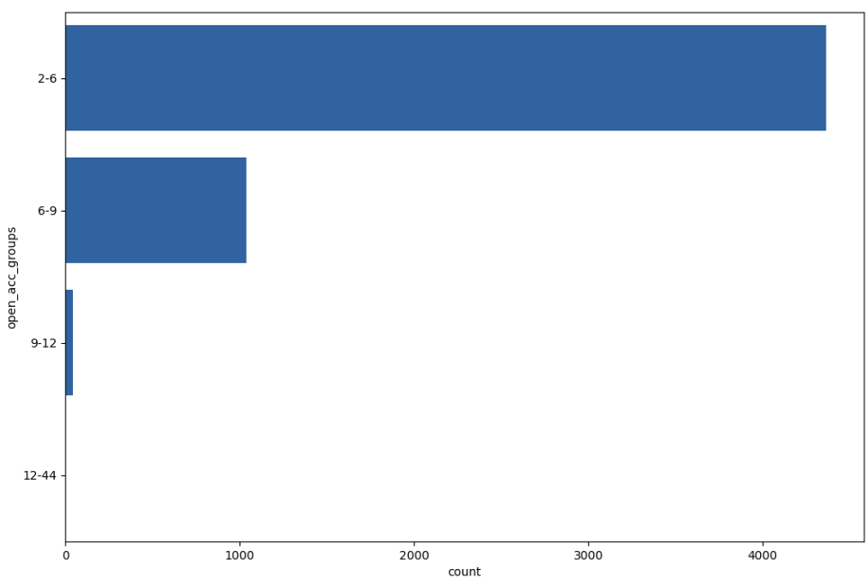
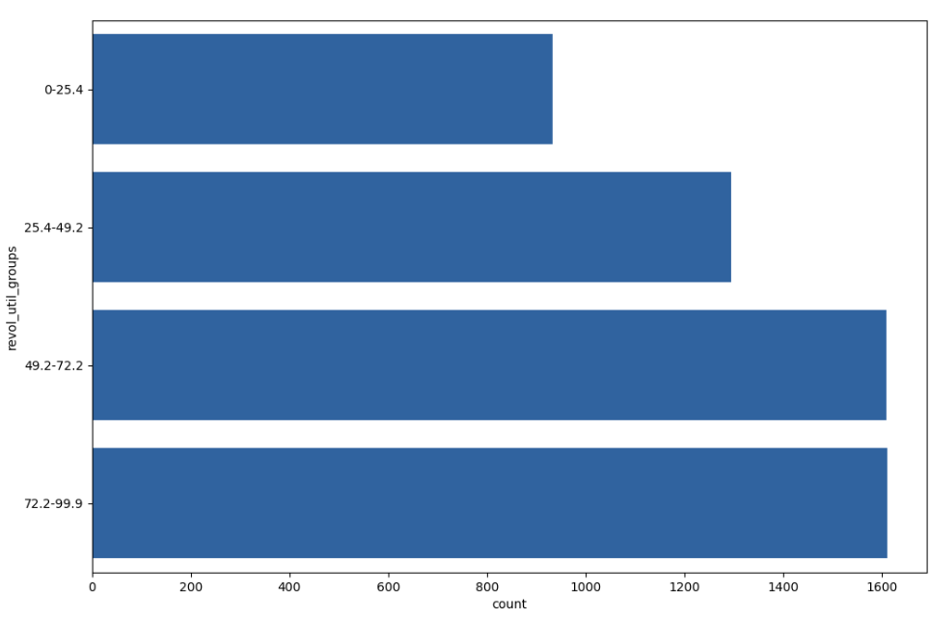
3. Open Acct and Revol_Util
Open Acct: Max defaulters are in the range 2-6. Percentage is 80.102 followed by 6-9 range at 10.05% min defaulters are in range 12-44 at 0.03%
Revol_Util: The amount of credit the borrower is using relative to all available revolving credit the highest range is 72.2-99.9 followed by 49.2-72.2 both are 25.5% chance of this group to default is the highest.

Slide 7
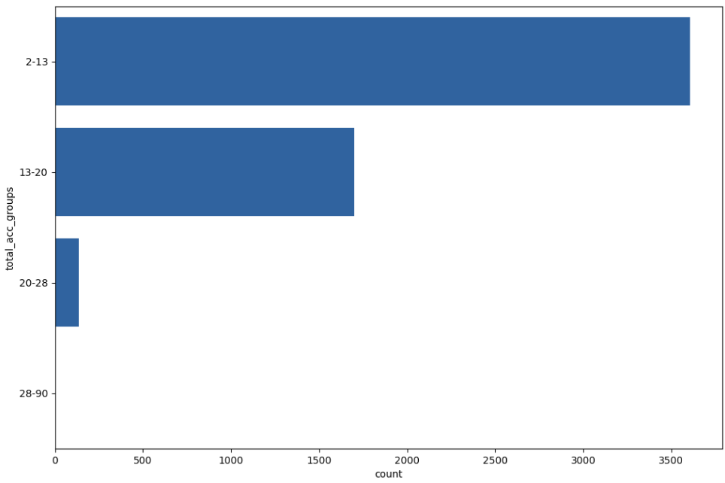
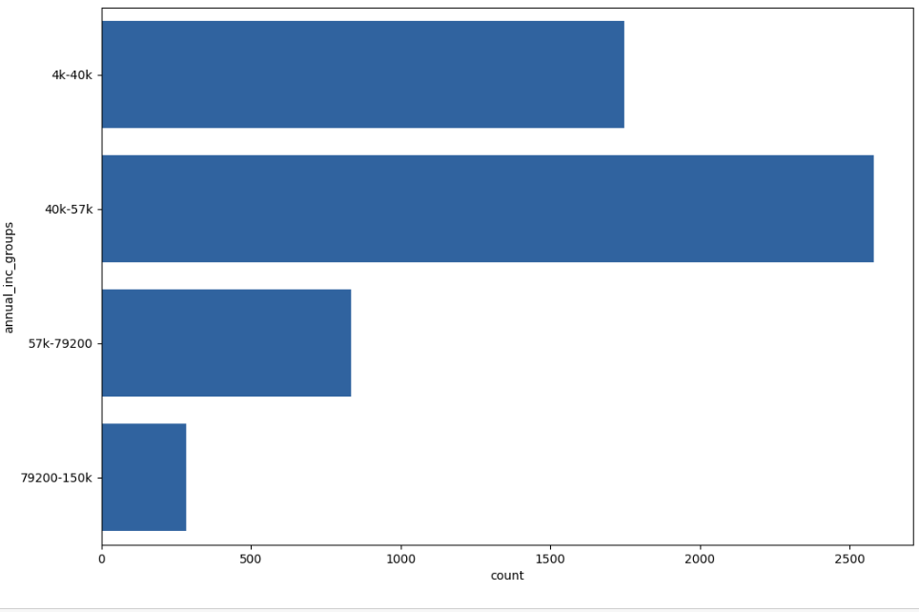
4.Total Acct and Annual_Inc
Total Acct: The total credit lines currently in the borrower’s credit file the lesser the credit lines the more the chances of default. 66.22% in range 2-13 default
Annual_Inc: People who have declared salaries in the 40-57K range are high defaulters (47.39%). The lowest one’s are in range whose salaries are above 80K (5% only)

Slide 8
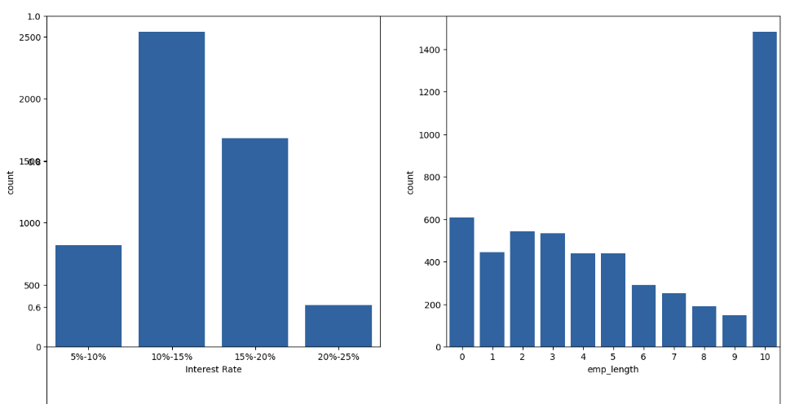
5.Interest Rate and Emp Length
Interest Rates: High defaulters are in the range 10-15 bracket
Empl_length: Employees with 10+ years of experience are more likely to default

Slide 9
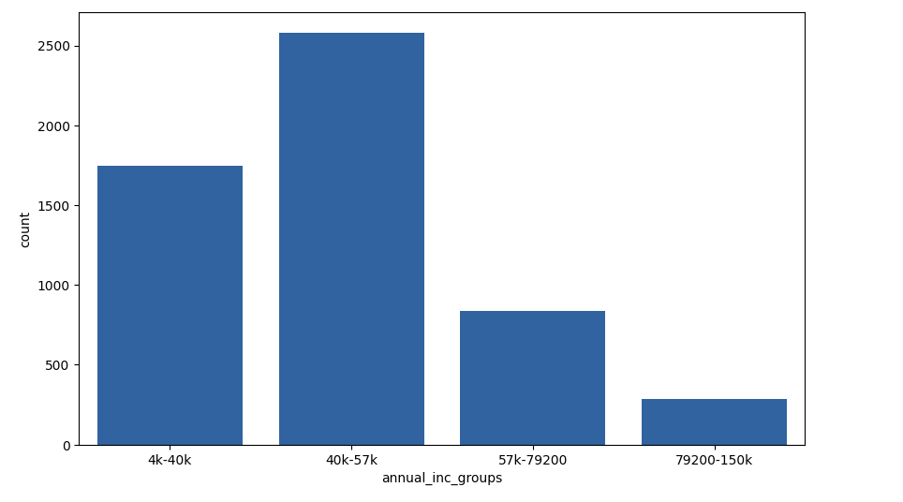
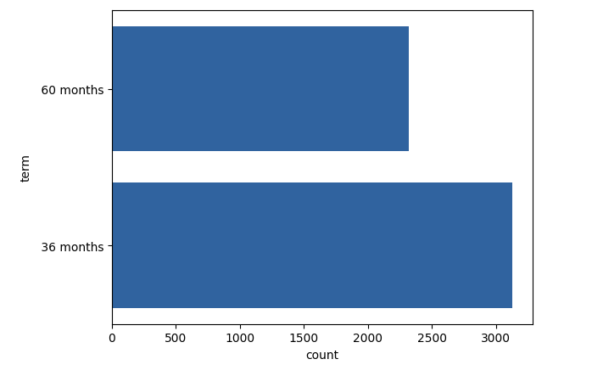
6.Annual Income and Term
Annual Income: 40K-57K salaries individuals have the highest probability of defaulting
Term: Those who take loans for lower term are more likely to default

Slide 10
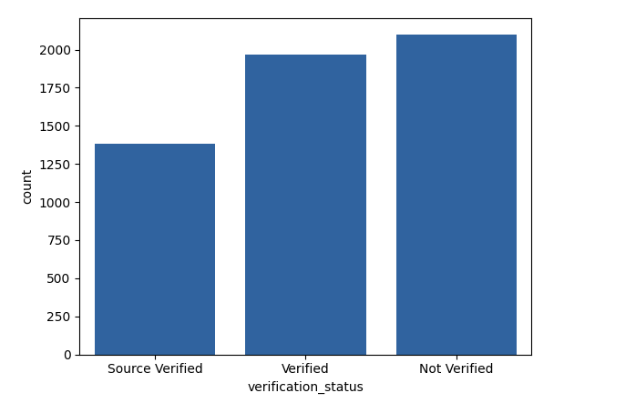
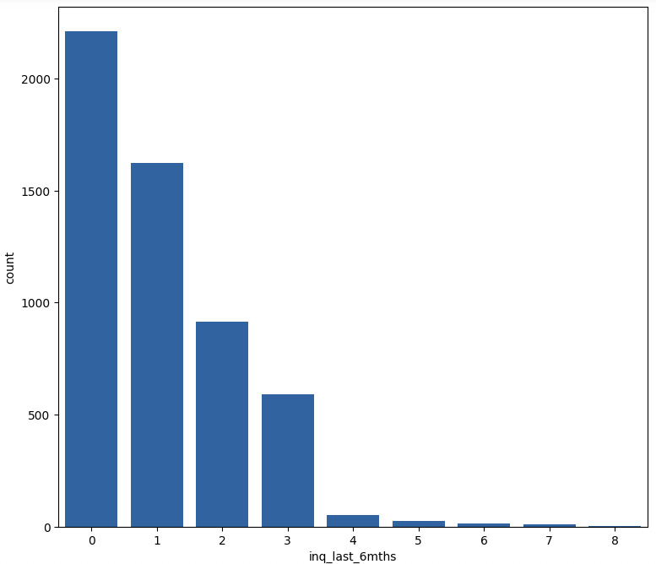
7.Verification Status and Inq Last Months
Verification Status: Unverified accounts are more likely to default. They top the chart with 38.5% probability of default at 25% the verified accounts are the lowest to default.
Last 6 Months: Those who did no enquiry in the last 6 months are at 40% of total defaulters. The more you enquire for a loan the lesser the chances of you defaulting since you have done the math and are prepared.

Slide 11
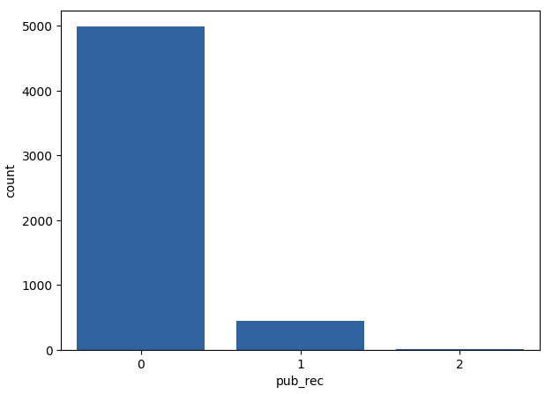
8.Pub_Rec
Pub_Rec: Zero derogatory records on credit score are more likely to default. Their probability is as high as 91.5%

Slide 12
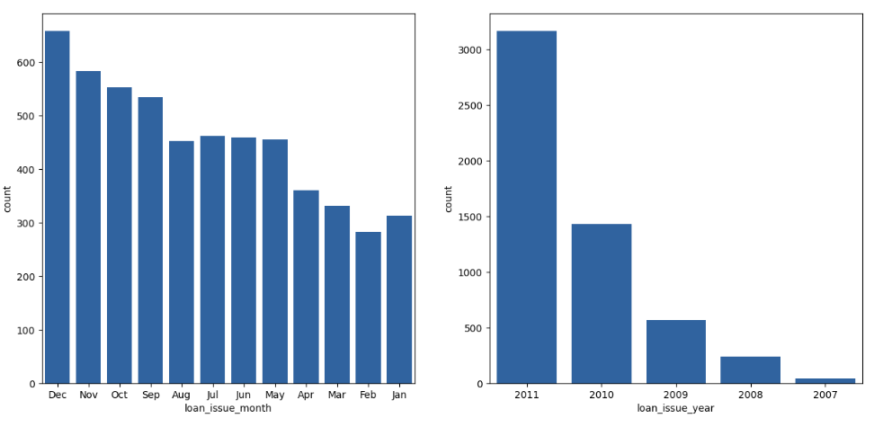
9.Loan Issue Month & Year
Loan Issue Month: December month see’s the highest lapses which is 12.09% followed by Nov and October at 10.70 & 10.15 percent
Loan_Issue_Year : 2011 had the highest lapse at 58.16% the lowest lapse was at 0.77% in the year 2007

Slide 13
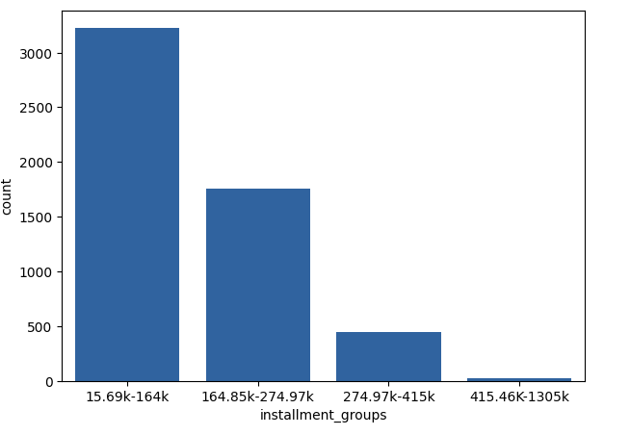
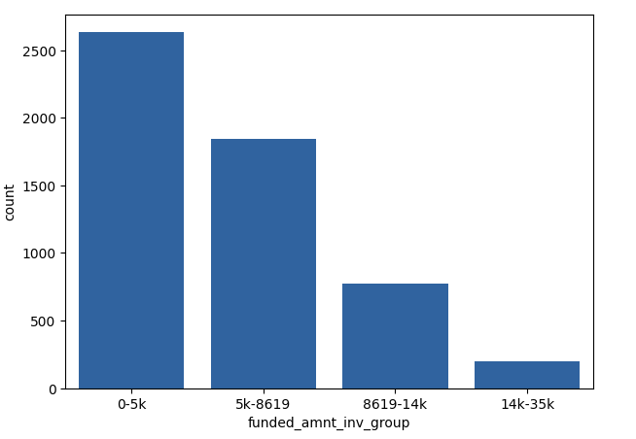
10.Instalments and Funded Amount Inv
Instalments in range 15.69K to 164K tend to falter more. The higher the instalments the lower the risk
Funded Amount Inv. The lower the commitment by the investor the higher the default. 0-5K has the highest count. Its 48.38%

Slide 14
Recommendations 1
There is more probability of defaulting when person applying for loan :
Has house_ownership as 'RENT’
Uses the loan to clear other debts
Receives interest at the rate of 10-16%
Has an income of range 31201 - 58402
Has 2-6 open_acc
Has revolving line between 49 and 99
Has experience of 10 years or more
Has term of 36 months
Has loan status as Not verified
Has credit lines between 2-13
Has declared annual salaries in group 40K to 57K
Has made zero enquires in the last 6 months
Has derogatory public records equal to 0
Has taken the loan or purpose as 'debt_consolidation’
Has DTI inbetween 10-16 and Loan amount is 500 to 5200

Slide 15
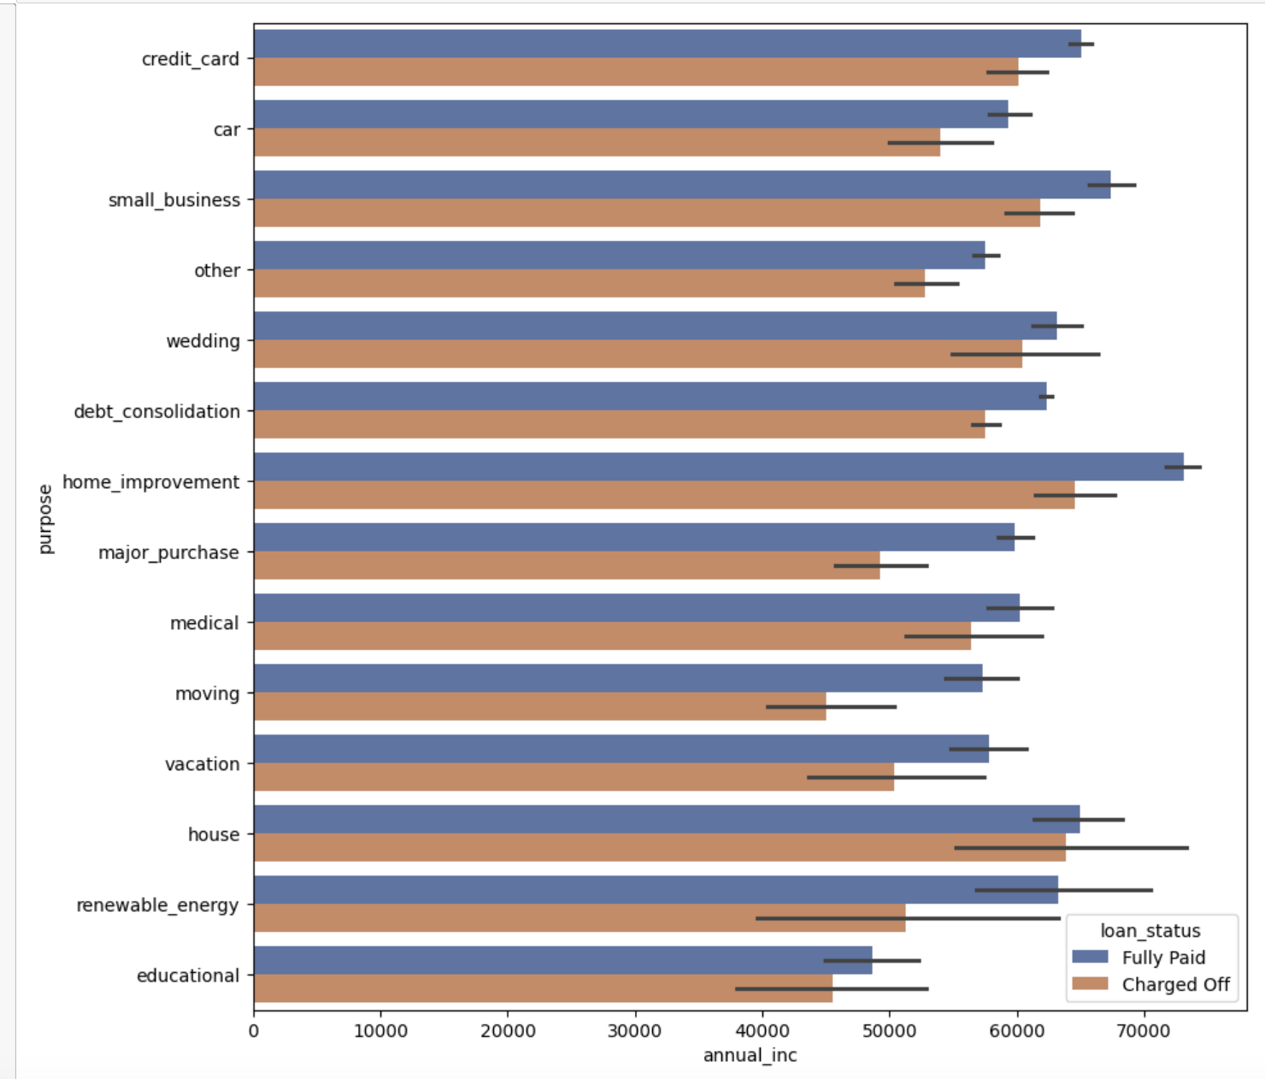
12.Income to Purpose Relationship
Applicants with high salaries mostly default on home improvements, house and small business
Applicants on lower paygrade 40-50K default on education and moving.

Slide 16
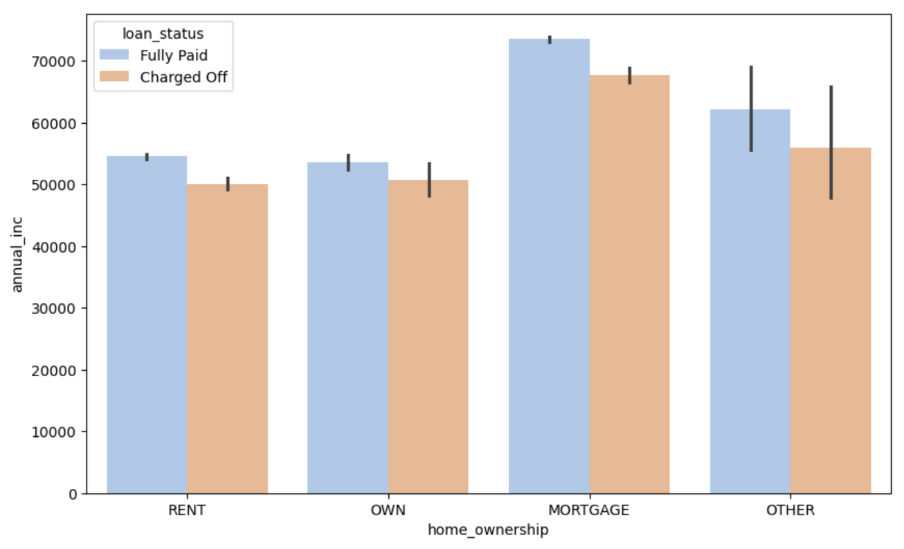
13.Income to Home Ownership
Applicants with high salaries default on Mortgage payments.
Applicants on lower paygrade 40-50K default on Rent and ownership.

Slide 17
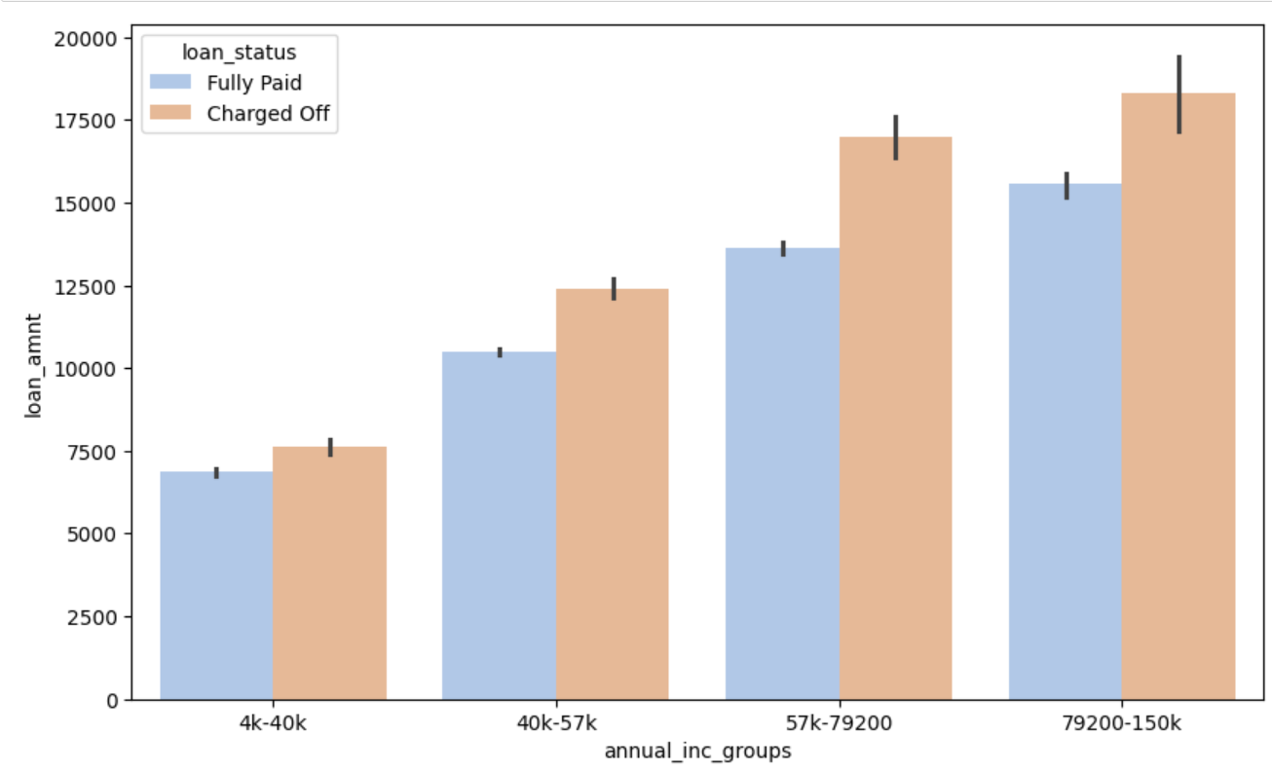
14. Loan Amount to Annual Income
Applicants with high salaries default on Mortgage payments.
Applicants on lower paygrade 40-50K default on Rent and ownership.

Slide 18
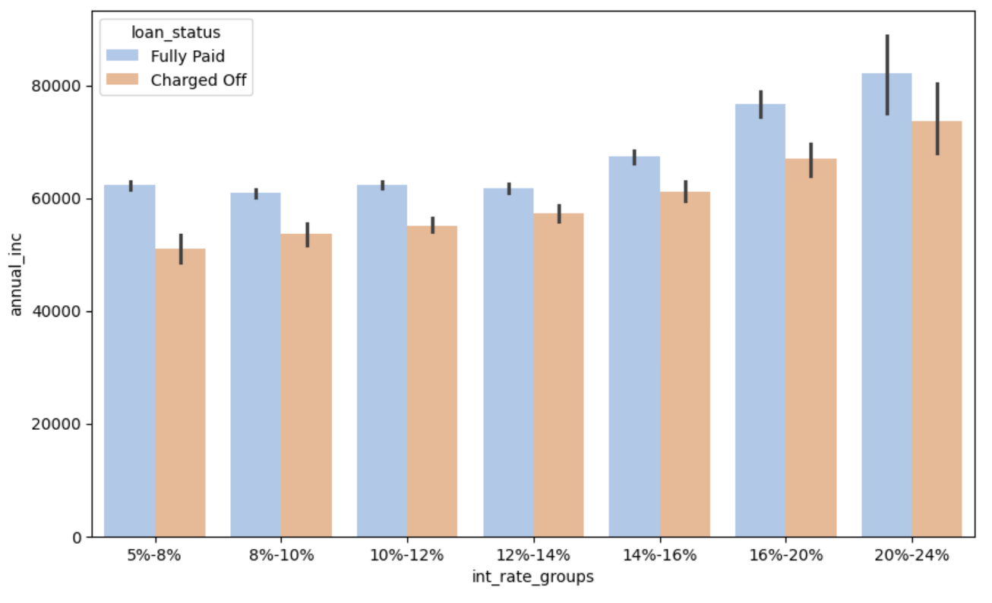
15. Annual Income to Interest Rates
Applicants with high income paid 3.5 times the interest rates.
At around 50K the interest rates are 5-8%. The the higher the interest rates the greater the chances of default even though the incomes are higher.

Slide 19
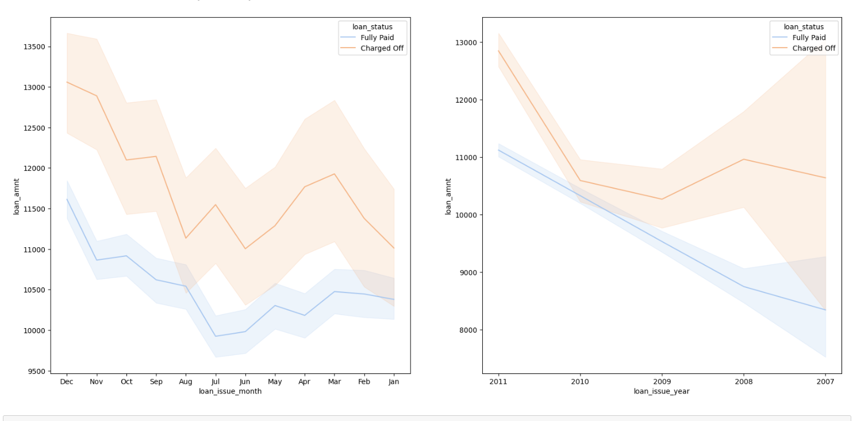
16. Year and Month with highest default
Applicants in December Default the Most.
2011 was particularly bad when it comes to default.

Slide 20
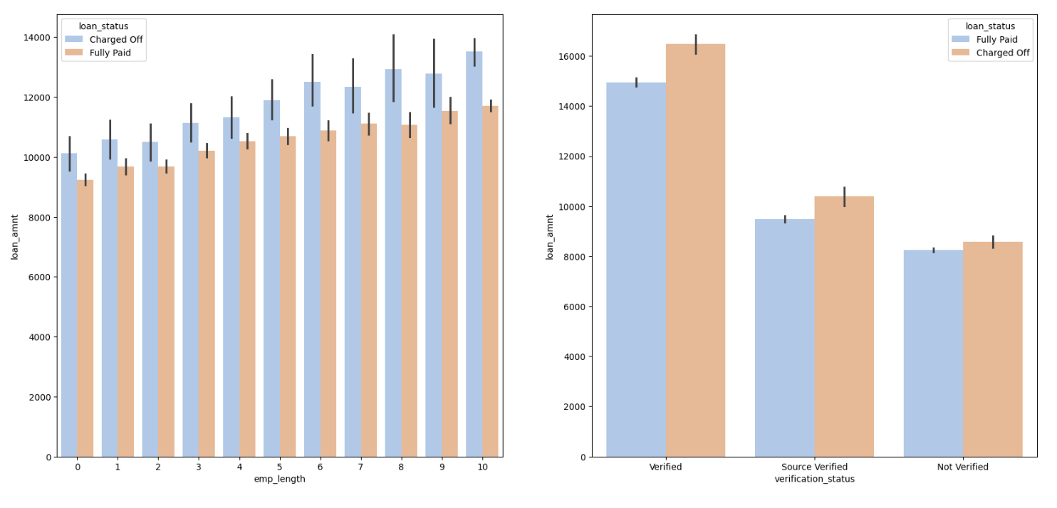
17. Loan Amt Vs Emp Length / Loan Amt Vs Verification Status
Employees with 10 years or more experience have a higher loan and default the most.
The higher loan amount are verified first but they default the most. At a loan of 8000 or lesser the verification process is low.

Slide 21
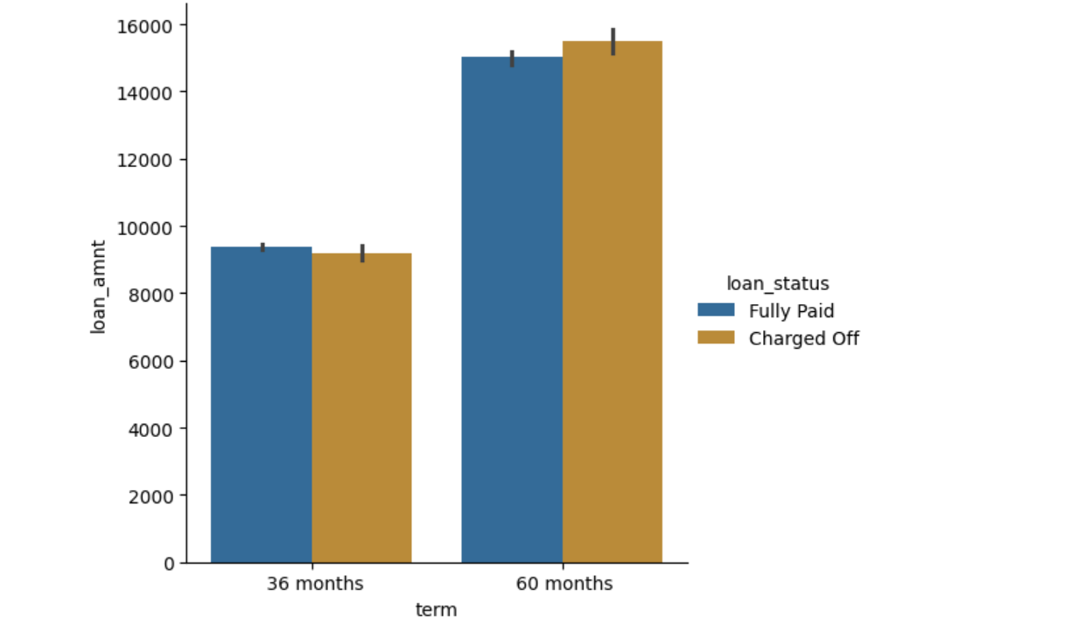
18. Loan Amt Vs Term
As the loan amount increases the tenure increases and so does the default
Smaller loans for a short duration do better.

Slide 22
Recommendations 2
#Observations
The chance of defaulting goes up when :
Applicants taking loan for 'home improvement' and have income of 60k -70k
Applicants with ownership type as 'MORTGAGE and have income of ~65-70k
Loans of 5to7K from applicants earning 4K-40K are less risky than high earning high loans.
Applicants who receive interest at the rate of 21-24% and have an income of 70k-80k
Applicants who have salaries less than 50K and lower interest rates (5-8%) have also defaulted
Applicants whose home ownership is 'MORTGAGE and have loan of 14-16k
When employment length is 10yrs and loan amount is 12k-14k
When the loan is verified, and loan amount is above 16k

